Slide 1
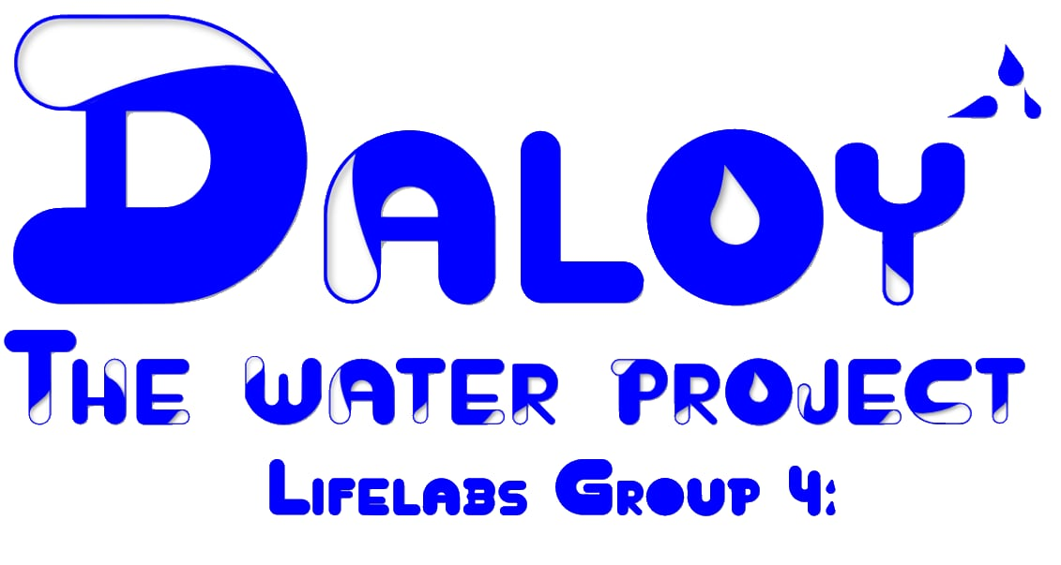

Slide 2
DESIGN THINKING PROCESS
1. EMPHATIZE | Pollution hurts not just our environment but all of us, When the air is polluted, and water turns dirty, animals and humans suffering from environmental pollution, it is sad that our planet is suffering because of waste not being disposed of properly, it reminds us that we have to care about the earth, and keep it alive, to do our part so that earth doesn't have to suffer anymore.
2. DEFINE | Rural communities face unsafe water due to pollution, making it hard for AFA learners and families to access clean water for farming, fishing, and daily life. The challenge is how we can ensure safe and sustainable water for both learning and livelihood
3. IDEATE | We arrived at this solution to AFA by thinking of multiple strategies like the (1) Teaching people or awareness campaign programs; (2) 3R’s - Recycle, Reuse and Reduce. However, these strategies are out-dated and most are not even followed. The group conceptualizes strategies to educate the public and be aware of the current situation of the environment. Aside from Recycle, Reuse and Reduce. The group is exploring for water filtration. This way we help minimize the problem and reach common goals.

Slide 3
DESIGN THINKING PROCESS
4. PROTOTYPE | The Water Project - D.A.L.O.Y The filtration process follows a sequential path: 1. Big Stones (Initial Layer). It removes larger particles and provides structural support. 2. Small Stones. Filters medium size particles and adds another layer of sediment control 3. Charcoal. This layers should absorb impurities, odor and chemicals 4. Clean Cloth. It acts as a pre-filter to trap small sediments and prevent possible clogging next layers. 5. Sand. It serves as fine filtration of small particles 6. Cotton(Final Layer). Polishes the water and catches any remaining fine particles. This stage ensures clarity before collection.
3. TESTING | To validate the functionality of the DALOY water filtration model, a testing phase will be conducted and documented through a video demonstration. This video will showcase the filtration process from dirty water to clean output.

Slide 4
HOW DOES IT WORK?

Slide 5
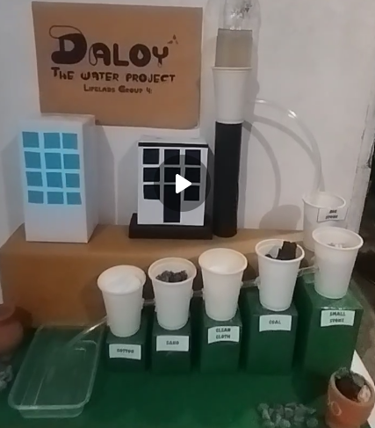
Dirty Water

Slide 6
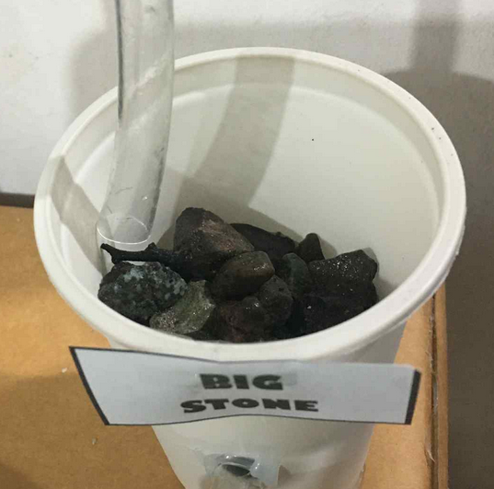

Slide 7
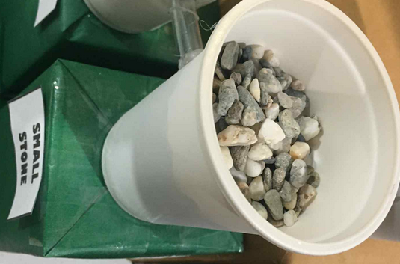

Slide 8
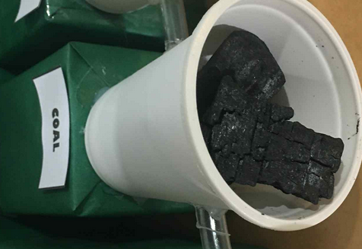

Slide 9
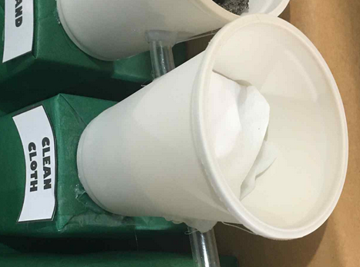

Slide 10
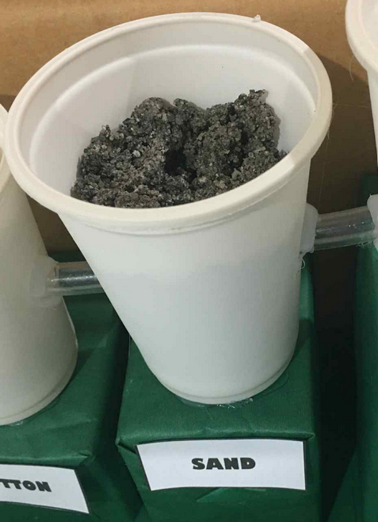

Slide 11
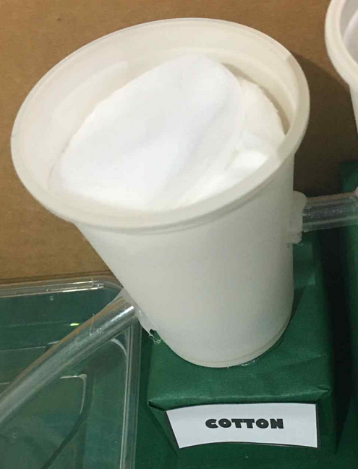

Slide 12
Clean Water

Slide 13
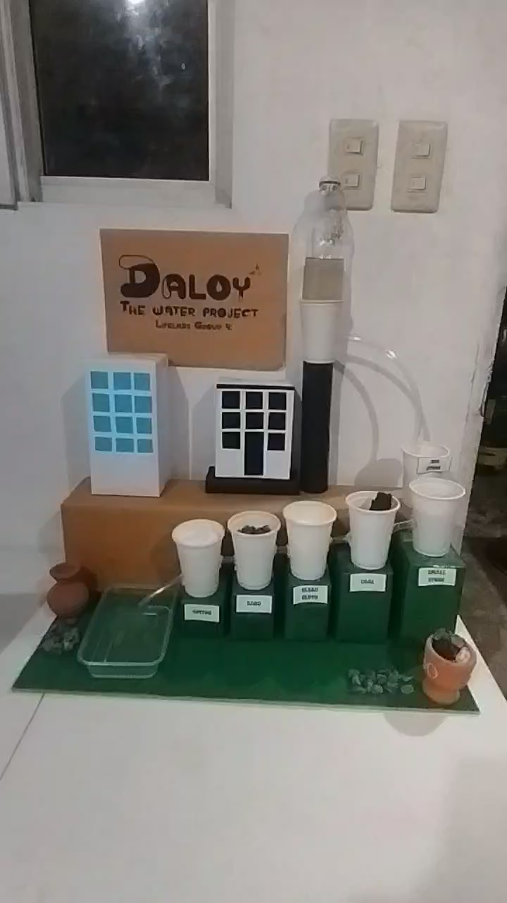
Prototype

Slide 14
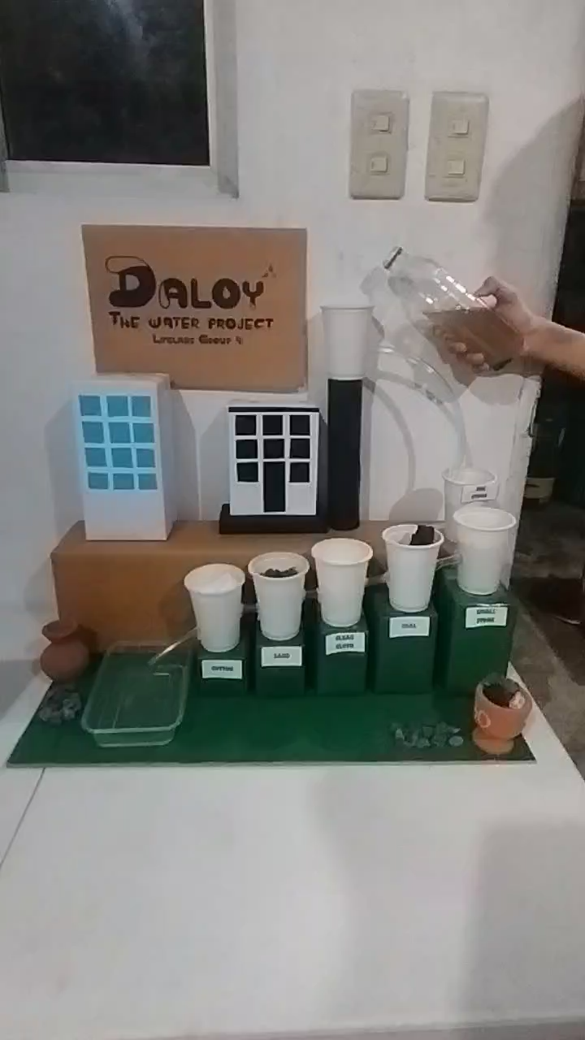
Testing

